Slide 1


Introduction to Microsoft Azure BizTalk Services
SQLSaturday #341 Porto 2014
Sandro Pereira
Senior Software Developer
Microsoft Integration MVP

Slide 2


Sandro Pereira
Senior Software Developer at DevScope
Microsoft Integration MVP since 2011
Member and co-founder of BizTalkCrew – BizTalk Innovation Day Events
Writer of numerous articles for Portuguese eMagazine “Programar”
Author “Sandro Pereira BizTalk Blog” http://sandroaspbiztalkblog.wordpress.com
Member of “BizTalkAdminsblogging.com” and “BizTalk Brasil” community
Member NetPonto community, MSDN BizTalk Forums Moderator
TechNet Wiki author (Wiki Ninja)
TechNet Gallery, Code Gallery and CodePlex contributor
Public speaker
Technical Reviewer PACKT Publishing
BizTalk Server 2010 Cookbook (April 2012)
Author book: BizTalk Mapping Patterns and Best Practices

Slide 3


12 Mapper Patterns
365 pages
4 Technical Reviewers
Steef-Jan Wiggers, Nino Crudele, Michael Stephenson, José António Silva
FREE BOOK!
http://www.biztalk360.com/biztalk-mapping-patterns/
BizTalk Mapping Patterns and Best Practices
Sandro Pereira
brought to you by

Slide 4

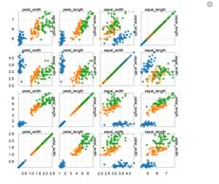
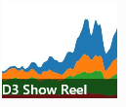
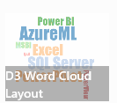
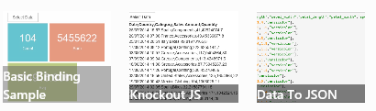

Devscope Sponsor Session
demos, demos, demos,…
… and PRIZES too:
15H NetPonto room

Slide 5
Agenda
Introduction - Evolving Integration Needs
Microsoft Azure BizTalk Services Overview
How can I get Started!
Migration Challenges
Demos
Key Takeaways

Slide 6
Evolving Integration Needs
The current stack integration From Microsoft

Slide 7



Current Microsoft integration stack
BizTalk Server
.NET/WCF/
AppFabric
Windows Azure Service Bus
Other
Notes:
BizTalk - desde 2000/2002 – 9 versão – 14 Anos - Revolução em 2004, as tecnologias / padrões (mapper, CBR - content-based routing, PubSub) Maior concorrente do BizTalk? . NET -> WCF -> AppFabric Server. Outros = SSIS / SQL Server Service Broker / StreamInsight / NServiceBus.

Slide 8




Evolving Integration Needs - New Challenges
Cloud services
Connected
Many applications
2010 Cloud
2000 SOA
1990 Web
1980 Client-Server
1970 Mainframe
Notes:
Novos desafios de integração – Aplicações On-Prem trocam informações com serviços em nuvem e queremos uma forma decente de os ligar
Soluções Híbridas – Cloud Services têm propriedades singulares e específicas: elasticidade, pay-per-use, self-service, sempre disponíveis
Essas propriedades são todas bem-vinda ao mundo da integração: quem viu um BizTalk Server HA / DR cenário estruturado? Elasticidade: agora podemos dimensionada com base: carga de pico, custo ou disponibilidade – conforme a criticidade do negócio A integração é muito importante, mas os recursos são escassos, portanto, caro

Slide 9
Microsoft Integration - The Cloud on Your Terms
Connect to the Cloud
Connect your Existing apps to the cloud
Build out your business without building new datacenters
Run in the Cloud
Run existing integrations in the cloud without re-write
Clear up on-prem infrastructure capacity; provision in minutes not weeks
Build for the Cloud
Design and build your new integration solutions to take full advantage of Platform as a Service
Connect to SaaS to SaaS and to on-prem
Notes:
Integration plays a key role. Here are the main scenarios we hear from customers:
Connect:
-- Integrate with cloud applications or external partners
Run:
-- Fast provision of a test environment, or just scaling out
Build:
-- Use the cloud as a managed integration platform in itself

Slide 10
Microsoft Integration - The Cloud on Your Terms
Connect to the Cloud
BizTalk Server 2013/2013 R2
Run in the Cloud
BizTalk Server 2013/2013 R2 in Microsoft Azure
Build for the Cloud
Microsoft Azure BizTalk Services*
* Previously referred to as “Windows Azure Service Bus EAI and EDI LABS”
Notes:
Integration plays a key role. Here are the main scenarios we hear from customers:
Connect:
-- Integrate with cloud applications or external partners
Run:
-- Fast provision of a test environment, or just scaling out
Build:
-- Use the cloud as a managed integration platform in itself

Slide 11



Bring the Cloud to your Enterprise: Infrastructure
MicrosoftAzure
Active Directory
SharePoint
SQL Server
Virtual Network
Your
Data Center
applications
Storage
servers
databases
Notes:
Two major ways to bring cloud compute to your enterprise:
First is at the infrastructure level:
Virtual network,
WA AD
System Center
Cloud backup for SQL Server
Windows Server
etc.

Slide 12

Bring the Cloud to your Enterprise: Integration
Microsoft Azure
SaaS
Apps
Partners
BizTalk Service
Service Bus
Your
Data Center
BizTalk Server
BizTalk Adapter Service
applications
mainframe
servers
databases
Notes:
Another key way to use the cloud is though integration.
Windows Azure provides a great environment for running web apps and public facing services.
Also a great “DMZ” for connecting with partners.

Slide 13
Microsoft Azure BizTalk Services
Notes:
Microsoft Azure BizTalk Services fornece capacidades de integração comuns (por exemplo, bridges, transforms, B2B messaging) no Microsoft Azure
Microsoft Azure BizTalk Services fornece a capacidades de integração para a plataforma Microsoft Azure para estender aplicações locais para a nuvem, fornece endpoints na nuvem para processar e transformar as mensagens e ajuda as organizações a integrar os seus sistemas/processos com diferentes sistemas, tanto no nuvem como locais.
Os recursos disponibilizados permite-nos dois cenários importantes sobre o Microsoft Azure:

Slide 14
Microsoft Azure BizTalk Services
Mgmt./tools/infra.
On-demand, per tenant, dedicated deployment that provides isolation and predictable performance
Easy provisioning
Disaster recovery
Backup and restore
Programmatic access to management functions
Schema editor/test map in VS
Bridge configuration surface
Mapper Migration Tool Agreement Migration Tool
EAI
Transport adapters for FTP/FTPs, SFTP, HTTP
Hybrid connectivity to SQL, SAP, Oracle EBS, Oracle DB
Content based routing to Web services, SB queues, topics, relays
Transformation engine
Out-of-box integration pattern
Custom code in Bridge
B2B
EDI AS2 and X12
Trading Partner Management
Agreements config templates
EDI batching
Tracking
Archiving with NRR
TPM OM API
Notes:
Microsoft Azure BizTalk Services fornece capacidades de integração comuns (por exemplo, bridges, transforms, B2B messaging) no Microsoft Azure
Microsoft Azure BizTalk Services fornece a capacidades de integração para a plataforma Microsoft Azure para estender aplicações locais para a nuvem, fornece endpoints na nuvem para processar e transformar as mensagens e ajuda as organizações a integrar os seus sistemas/processos com diferentes sistemas, tanto no nuvem como locais.
Os recursos disponibilizados permite-nos dois cenários importantes sobre o Microsoft Azure:

Slide 15
Microsoft Azure BizTalk Services – Feb 2014 Update
Support for EDIFACT Protocol
Improved Azure Service Bus integration
Simplified setup for on premise connectivity
Scheduled auto backup capability
Support for Operations logs
Notes:
Disponibiliza uma série de funcionalidade comuns que são utilizada na integração de sistemas.
XML Bridge – Protocol bridging, Route Actions, External data lookup for Message Enrichment, Internal Service Monitoring, enhanced and easier-to-use bridge configuration experience, simpler setup experience and support for REST messages
Transforms – Container based scoping for loop operations, validation and testing, mapper usability enhancements, cumulative data support, date time operations, data look up support, intermediate data storage support, message context access
Service Bus Connect – New server explorer experience for LOB creation, Management head accessed on-prem via Server Explorer or PowerShell to create, update, delete or retrieve information from LOB targets
B2B – AS2 protocol support with X12 chaining for send and receive pipelines, FTP as transport for X12, agreement templates, partners view with profiles per partner, resources view, intuitive metro style EDI Portal - Receiving and processing business transactions over EDI or XML messages.
Flat File Support - The bridge has been enhanced to process both positional and delimited flat files along with xml messages. It can also pull a message from your existing FTP server and then process it further

Slide 16
VETER
Transform
Connect LOB
EAI Capabilities
Enterprise Application Integration (EAI) which provide rich message processing capabilities and the ability to connect private cloud assets to the public cloud.
Notes:
Until now, only routing functionality (queues and topics)
VETER pattern in a bridge (AKA pipeline) - Validate-Enrich-Transform-Enrich-Route (VETER)
Transform (AKA BizTalk mapper with a new looks)
LOB systems connections through Service Bus Relay

Slide 17

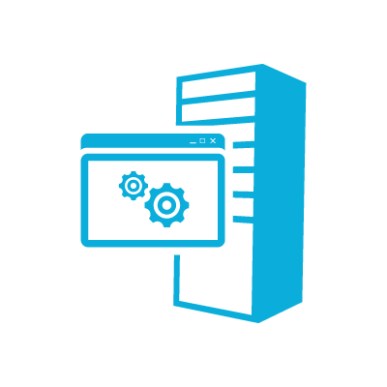



EAI – Incident Management Scenario
Web
Service
Bridge
User 1 via phone
customerType == “VIP”
EAI Bridge
(routing based on condition)
User 2 via online
LOB Relay
Behind Constoso’s Firewall
Partners
FTP Shares could be on-premise or in Cloud
customerType == “Default”
Service Bus Connect
Line of Business System
Validate – Enrich – Transform – Enrich - Route (VETER)
FTP Share 1
LOB Target
FTP Share 2
Notes:
Bridge: A Service Bus EAI and EDI component that processes, transforms, and transports data between two disparate systems.
LOB Relay: A URL in the cloud. Acts as a container for the LOB Targets.
LOB Target: The Line-Of-Business (LOB) system connection URI that includes the schema operation and connection credentials used to communicate with Line-of-Business (LOB) system.
Service Bus Connect: The Service Bus Connect feature allows an application in the cloud to communicate with a Line-of-Business (LOB) system on-premise, in your network, behind your firewall. Using the LOB adapters in the BizTalk Adapter Pack (BAP), a Service Bus Connect application can execute LOB operations to the following on-premise LOB systems:
Microsoft SQL Server
Oracle Database
Oracle E-Business Suite
SAP
Siebel eBusiness Applications

Slide 18


B2B comm
Portal
EDI Capabilities
Electronic Data Interchange (EDI) targeted at business-to-business (B2B) scenarios in the form of a finished service built for trading partner management.
Notes:
transactions over EDI (X12) messages.
Portal to manage trading partners, EDI agreements.
This Labs release only supports X.12. We will be adding support for EDIFACT in our upcoming updates
In current X12 e EDIFACT (European), supported.

Slide 19

EDI Service Order Processing Scenario
TPM Portal
EDI App
EDI
EDI Bridge
Service Bus
Hybrid Connectivity
TPM
AS2
BAM
Orders
EDIFACT
X12
FTP
10.000+ EDI schemas
Sales Dashboard
(ASP .NET)
Order Management LOB System
Northwind
Contoso

Slide 20
How can I GET STARTED?
Microsoft Azure BizTalk Services

Slide 21

Requirements
Platform
Windows 7 Service Pack 1, Windows 8, Windows 8.1, Windows Server 2008 R2 SP1, Windows Server 2012, Windows Server 2012 R2
Microsoft Visual Studio 2012 - Microsoft Visual C# .NET is the minimum requirement, , .NET Framework 3.5 or 4.5
Microsoft Azure BizTalk Services SDK, June update
MicrosoftEdiXSDTemplates.zip
Tools.zip
WindowsAzureBizTalkServicesSetup-x64.exe
WindowsAzureBizTalkServicesSetup-x86.exe
You can download the Microsoft Azure BizTalk Services SDK from http://www.microsoft.com/en-us/download/details.aspx?id=39087
BizTalk Services Documentation http://msdn.microsoft.com/en-us/library/windowsazure/hh689864.aspx
Notes:
This includes the Visual Studio project templates for creating an Enterprise Application Integration project and an EDI Project.
This includes a Visual Studio Server Explorer plug-in for creating LOB Relays and LOB Targets. This also includes a runtime component that manages connectivity to the on-premises LOB applications.
EDI Schemas
This provides a Trading Partner Management portal for managing trading partners and all EDI message exchanges between those partners.

Slide 22
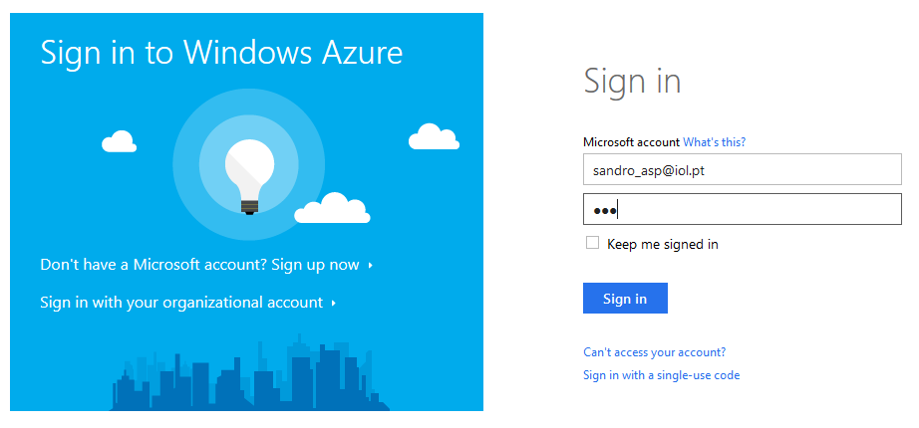
Provision a Microsoft Azure BizTalk Service

Slide 23
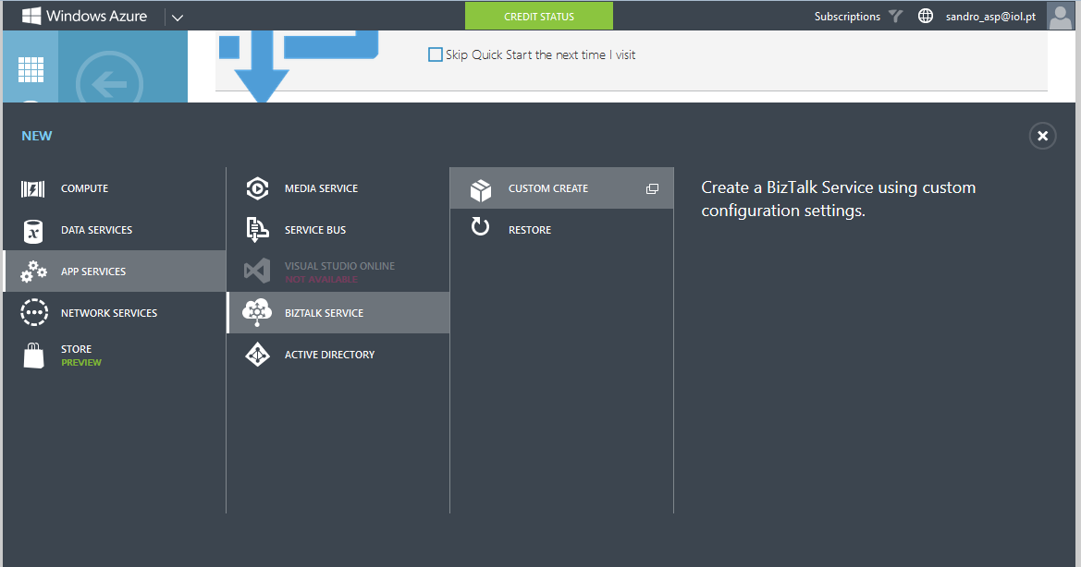
Provision a Microsoft Azure BizTalk Service

Slide 24
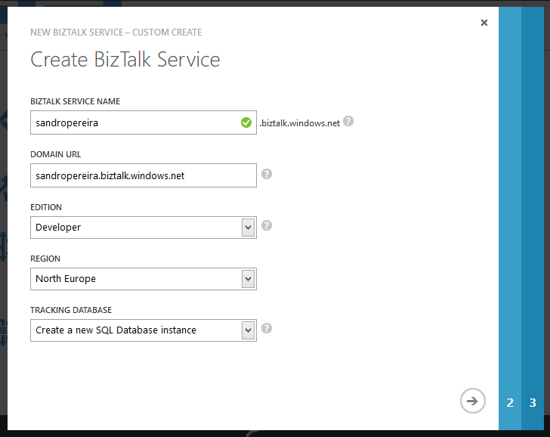
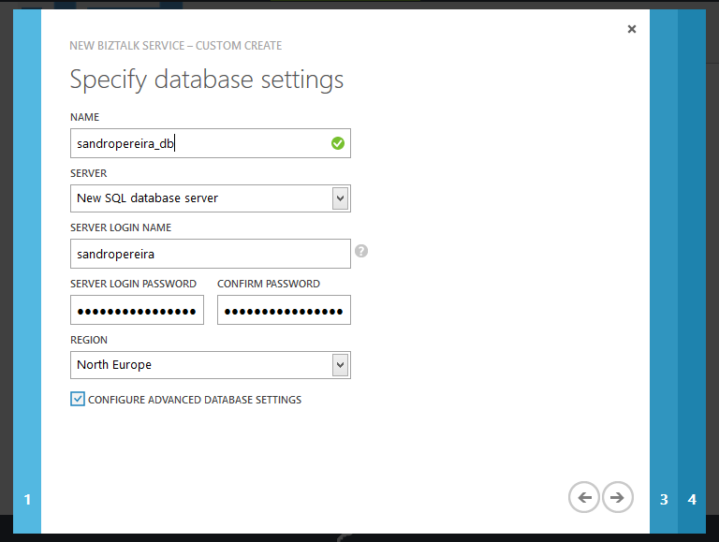
Provision a Microsoft Azure BizTalk Service

Slide 25
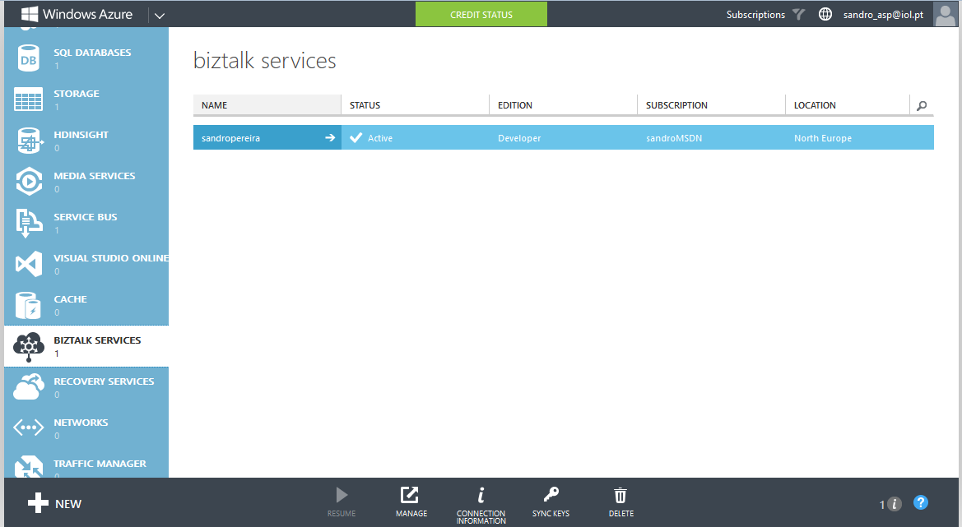
Provision a Microsoft Azure BizTalk Service

Slide 26
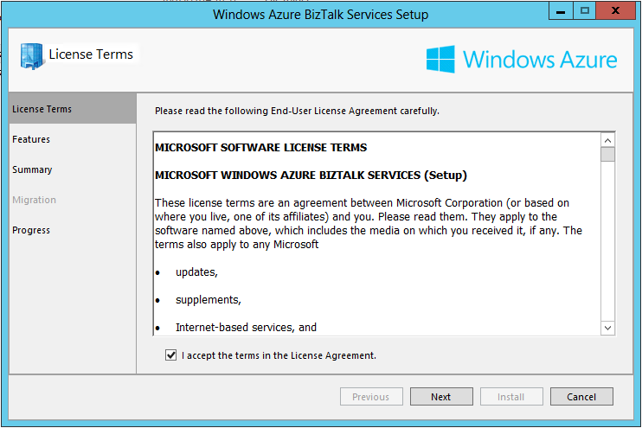
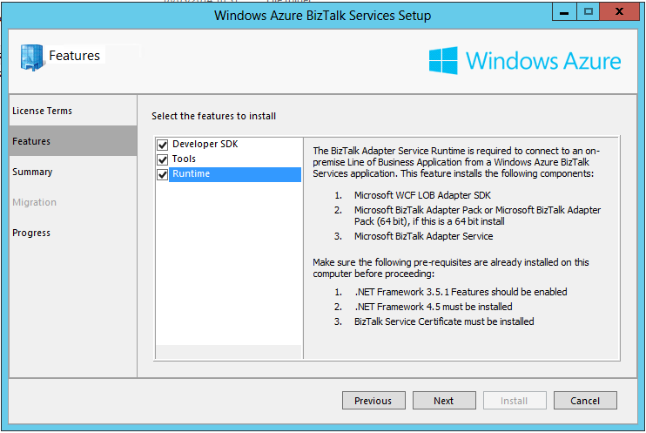
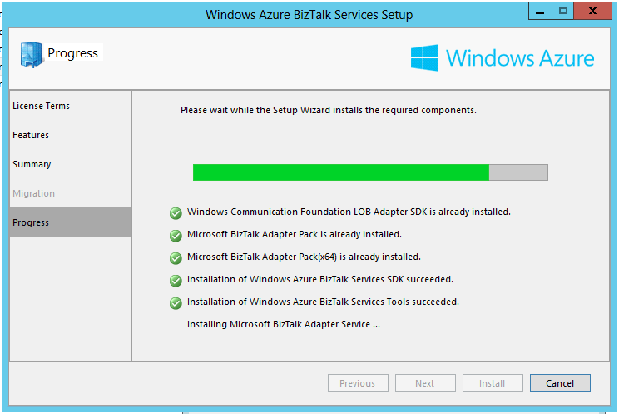
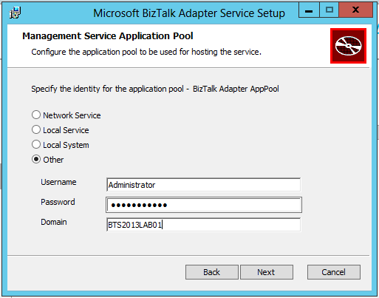
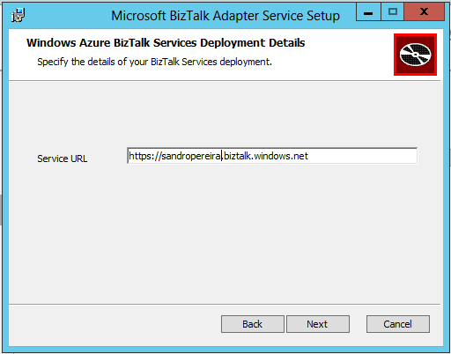
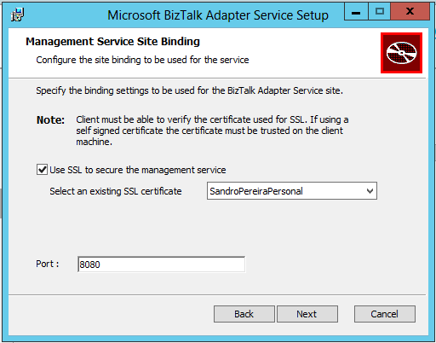
Installing Microsoft Azure BizTalk Services SDK

Slide 27
Migration Challenges
Main differences and challengers between BizTalk Server and MABS

Slide 28


The Challenge
XML EDI or Flat File
XML EDI or Flat File
BizTalk Server architecture
Ports
Pipelines
Maps
Orchestration
Rules
Adapters
EDI TPM
BAM, Tracking
Oh my!
Receive Port
Orchestration
Send Port
Receive Adapter
Receive Location
Send Adapter
Receive Pipeline
Send Pipeline
Mapping
Mapping
FROM: Contoso (Flat file format)
TO: NWTraders (Flat file format)
MessageBox
TO: Fabrikam (XML format)
FROM: Fabrikam (XML format)

Slide 29
BizTalk Services
BizTalk Service
BizTalk Portal
Partner OM
Partners
Agreements
Profiles
Partnerships
Monitoring Store
Visual Studio
Bridges
Xml One-Way
Xml Request Reply
Pass-Through
EDI (X12 & EDIFACT)
Artifacts
Tracking Store
PowerShell
Certificates
Assemblies
Schemas
Transforms
Notes:
I though it was a good idea to first have a look at what makes BizTalk Services tick

Slide 30
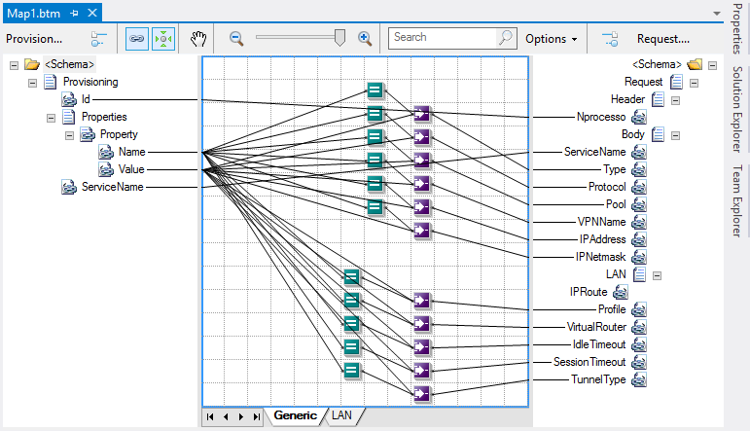
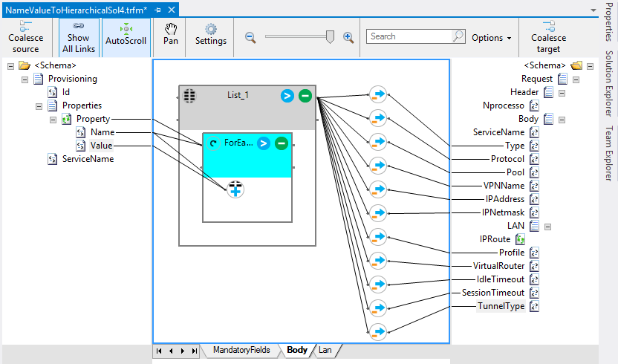
Maps
Mapping is fundamental to integration
But mapping has been rewritten in WABS
Still schema based and XML schema fully supported in WABS
Two approaches
Maps in BizTalk Server are ‘just’ XSLT most of the time – i.e. no code
Maps can be converted to transforms in WABS
WABS transforms can support XSLT (1.0)
WABS provides command line map conversion tool
BizTalk Mapper Design
Functoids (Advanced, Conversion, Cumulative, Database, Date and Time, Logical, Mathematical, Scientific, String)
The transformation are created using XSLT
Transform Designer
Operations (String Operations, Loop Operations, List Operations, Cumulative Operations, Date / Time Operations, Miscellaneous Operations, Expressions)
The transformation are created using Extensible Application Markup Language (XAML)

Slide 31
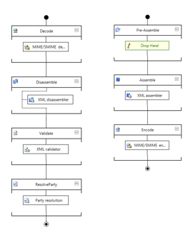
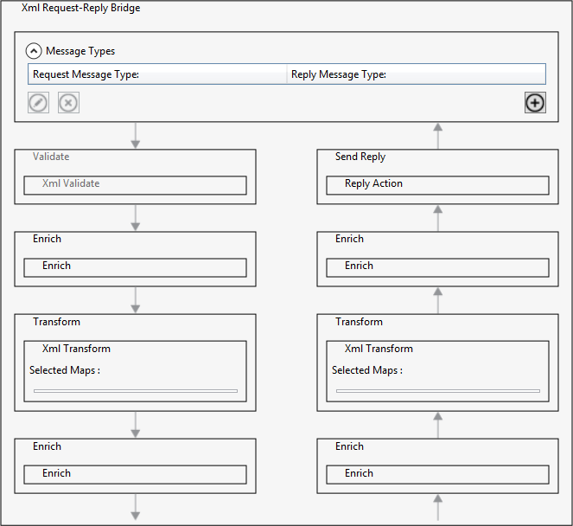
Pipelines
Bridges in WABS are a funky combination of pipeline and processing
Bridges are stateless
Bridges are not transactional (because they are stateless)
Bridges have predefined processing stages
Bridges allow custom code
Bridges can call other bridges
Bridge templates are not extensible
So bridges are pretty fundamental too
BizTalk Pipelines
Custom processing via pipeline components
MABS Bridges
Custom processing via message inspectors

Slide 32
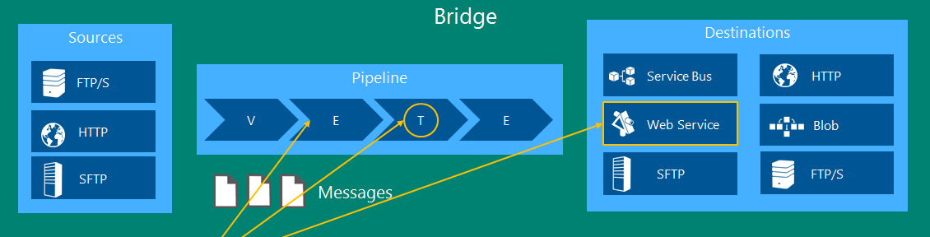

Bridges in BizTalk Services
1. Message Inspectors
2. Xml Transform
3. WCF Destinations
Notes:
Now we will have a look specifically at the Bridges

Slide 33
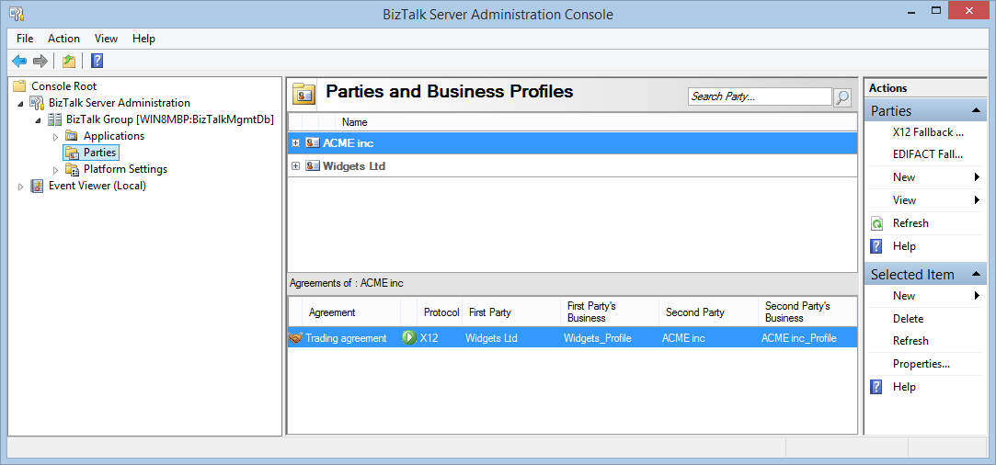
Trading Partner Management
MABS TPM is compatible with BizTalk Server
Tooling provided to move trading partners and agreements to WABS
MABS now supports EDIFACT as well as X12 and AS2

Slide 34
Now for the tough stuff
Orchestration migration
Hard problem to solve
But often used, often unnecessarily
Workflow is planned in service but not yet and not compatible
BAM / Tracking
WABS provides tracking infrastructure, SQL Azure database that is very useful for monitoring
Business activity monitoring is planned
BRE
Support is planned, aim is to be compatible with BizTalk rules
For now, workflow and workflow rules provides an alternative

Slide 35



State of the art
BizTalk Feature | WABS Feature/Alternative | Effort
Map | Transform | Tooling
Schema | Schema | Low
Pipeline | Bridge | Some
Adapter | Source/Destination | Depends
Orchestration | Workflow | High
BRE | Workflow rules | High
BAM / Tracking | Tracking | Medium
Trading partner mgmt. | Trading partner mgmt. | Low

Slide 36
What makes sense to move?
Not everything
May depends on data classification
Where data is coming from/going to
Not for On-prem <> on-prem EAI
But very useful for cloud <> cloud
It’s not all or nothing
Consider moving part of a solution to the cloud, keeping the rest on prem
Hybrid integration patterns are important

Slide 37
DEMO
EAI Capabilities (Transform, VETER, CBR, Connect LOB)
EDI Capabilities (B2B comm, Portal)

Slide 38
Key Takeaways
What’s next?

Slide 39
MABS Benefits
Managed by Microsoft
Customer Focus on Solutions
Scalable, Secure & Reliable
Dedicated Resources
Secure & Isolated environment
Predictable Performance
Better Availability & Control
Simplified Management
Rich Monitoring & Diagnostics
Business Continuity/ Disaster Recovery
Notes:
Cloud Advantage: cost effective, scalable infra, easy deployment
Cloud Challenge: data privacy/isolation, control
Power is with you as IT Admins
Scale up/down
Controlled hotfix and updates rollout (MS)
Advantages of Managed?
Creation of environment taken care by Microsoft
Any infrastructure issues taken care by Microsoft
Your BizTalk Service is monitored by Microsoft 24/7
OS updates, security patching on the VMs running your solution is taken care by Microsoft
You as an admin (customer) deal with the application issues. They are the responsibility of the customer
Advantages of the model:
Dedicated compute (no sharing)
User code isolation
Message processing security
Dedicated storage
Configuration security
Customized servicing
Challenge: Management

Slide 40
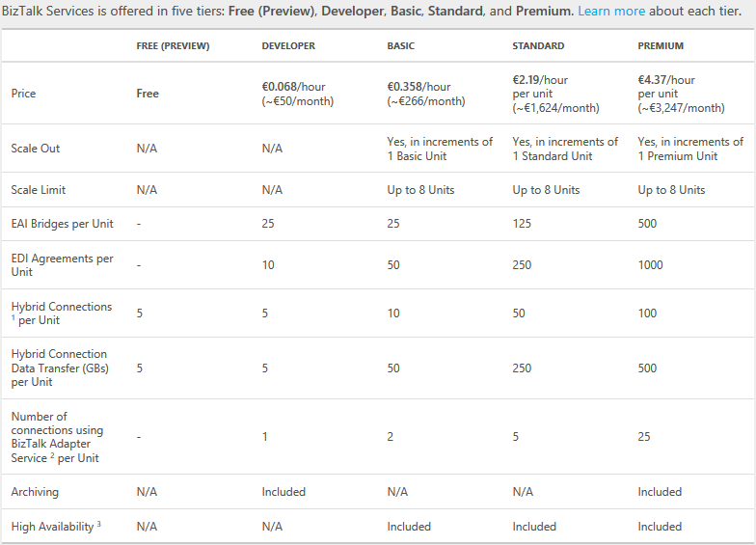
Pricing
http://www.windowsazure.com/en-us/pricing/details/biztalk-services/

Slide 41
Roadmap
BizTalk Service – Quarterly releases
BizTalk Server – 2 year Release cadence

Slide 42


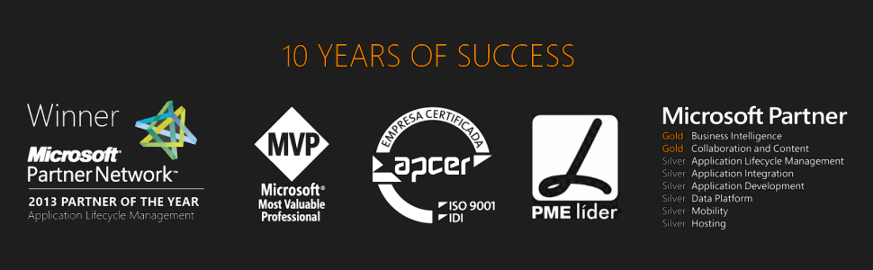


Questions?
sandro.pereira@devscope.net
linkedin.com/in/sandropereira
@sandro_asp
sandroaspbiztalkblog.wordpress.com
www.devscope.net

Slide 43
Thanks
+351 223 751 350
www.devscope.net

